Slide 1


News Translation and Summarization
In this presentation, we'll be discussing an exciting project that solves the problem of staying up to date with global news in different languages. Our team has developed a comprehensive solution for both summarisation and translation of news articles, making it easy for you to keep up with news from all around the world.
Team :
Shuvam Bose
Armaan Mittal
Anirudh Taawker
Pranav M

Slide 2

Outline
Abstract/Problem
Scope of the Project/Use-case
Core NLP concepts used in project
High Level Architecture /Detailed Flowchart
Explanation of Dataset & its Features
Screenshot of output
References

Slide 3

Abstract/Problem
Keeping up with the news can be an overwhelming task, especially when you have to sift through articles in different languages. Our project addresses this by providing a solution to summarise and translate news in just a few clicks.
This summarization is done using four different models, and the translation is done using the Da-Vinci model.

Slide 4
Scope of the Project/Use-case
Aiding journalists
Content curation
Efficient reading for users
Journalists can save time while reviewing large volumes of articles, helping them focus on their core work.
Summarised articles can be used to create curated content for readers’ convenience.
Users can get a quick summary of articles, saving them time and effort of reading through a lengthy article.

Slide 5

Core NLP concepts used in project
1
Preprocessing
2
OpenAI API
The removal of HTML tags, extra white spaces and converting text to lowercase.
We used OpenAI’s API for translation.
3
Bleurt Test
4
Tokenization
We used Bleurt Test to evaluate the accuracy of the translation.
Breaking text into smaller parts for better analysis.
5
Summarization
6
Prompt Engineering
Extractive and abstractive methods were used with four different models.
Used to improve the translation accuracy.

Slide 6
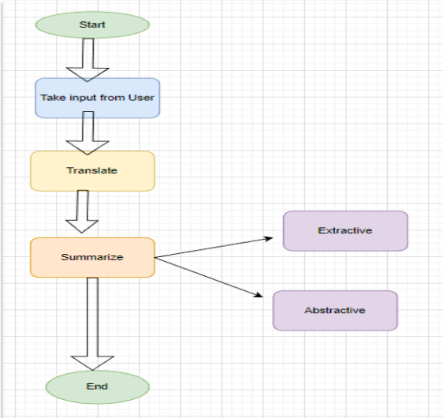
High Level Architecture / Detailed Flowchart

Slide 7
Explanation of Dataset & its Features
We used a dataset consisting of unstructured data in German and English which was sourced from a German news articles website. During preprocessing, we removed HTML tags, white spaces and other unnecessary symbols. Our translated version was tested against the English version of this dataset for accuracy.
Dataset Source: German News Articles
Obtained from: https://www.deutschland.de/de/news/deutschland-wirbt-um-pflegekraefte-aus-lateinamerika

Slide 8
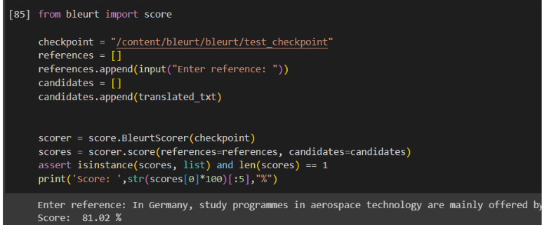
Screenshot of Outputs
Translator Output

Slide 9
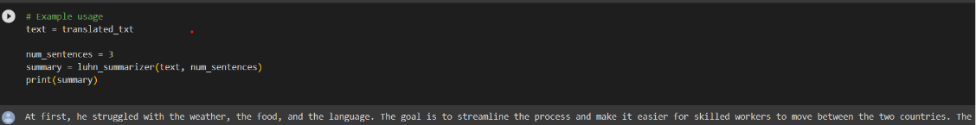
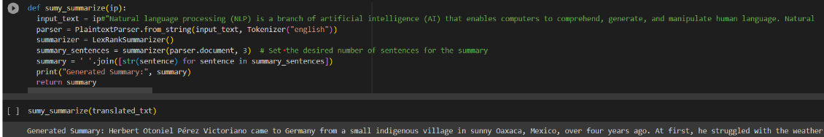
Screenshot of Outputs
Extractive Summarizer
LUHN
Lexrank

Slide 10
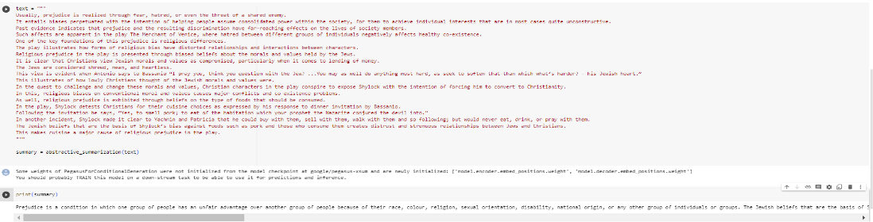
Screenshot of Outputs
Abstractive Summarizer
Pegasus

Slide 11
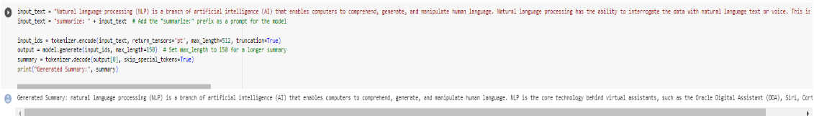
Screenshot of Outputs
Abstractive Summarizer
T-5

Slide 12

References
Pegasus
Luhn
T-5
Read the details about Google's Pegasus, a state-of-the-art model for text summarization.
Read more about Luhn's heuristic method for text summarization.
Explore transfer learning using T-5.
Lexrank
NLP Summarization Models
ROUGE
Learn about text summarization in NLP.
Get an overview of text summarization approaches in NLP.
Understand how ROUGE works for evaluation of summaries.

Slide 13
THANK YOU

